Slide 1

Introduction
By
Israel Lazar

Slide 2
Agenda
Introductions
Today’s Build & Release Challenges
BuildForge Overview
BuildForge & Terminology
Technology Overview
Integration & Value add to Rational Solutions
  Rational Unified Process
  RAD/Eclipse/.Net Developer Self-Service Plug-ins
  Rational ClearCase Adaptor
  Rational ClearQuest Adaptor

Slide 3
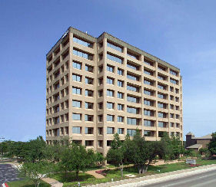
BuildForge – Who They Are ?
Formed in January of 2001. Headquartered in Austin, Texas
Addresses the challenges that exist in the build, test, and deployment phases of the software development process
Highlights
  BuildForge releases version 1.0 - March ’02
  Named to prestigious SD Times Top 100 - May ’05
  Validated “Ready for IBM Rational”- January ’06
  Acquired by IBM, May 2nd, 2006, joining the Rational brand
Proven results with marquis G2000 companies and ISV’s

Slide 4
Today’s Build & Release Challenges
Current Conditions
Business Impact
Manual, error-prone build processes
Proprietary internally-developed systems
Inconsistent processes across products and platforms
Dependence on build staff to execute, troubleshoot, and provide feedback
Inconsistency between developer environments and production systems
Time consuming to detect and resolve problems
Lack of traceability and compliance readiness
Unpredictable product release cycles
Costly systems to support & maintain with knowledge held by a few
Limited repeatability or portability for new projects and platforms
Staff burden, delays, lost productivity,
Unforeseen errors surface later in the release cycle
More people required to do more work
Extensive ad hoc effort spent in audit preparation
“Software build management increasingly impacts successful software deployments,
business and IT productivity and is becoming a focus for IT organizations. ” - IDC
Notes:
Customize for each customer. Put in their current challenges and change title with there name.

Slide 5
BuildForge - What We Do
BuildForge provides an adaptive framework that allows development teams to standardize and automate repetitive tasks, share essential product information, and respond quickly to change.
Areas we impact:
  Process efficiency: Reliable and scalable process
    Delivers automation, speed, productivity
  Sustainable compliance: Auditing and IT controls “baked in”
    Delivers audit trails, complete bill of materials, reproducibility
  Globally distributed teams: Integrated and in synch
    Delivers automated handoffs, streamlined communication, secure access
  Implementing agile methods: Developer self-service and continuous integration
    Delivers predictable quality, fewer errors, faster troubleshooting
Notes:
BuildForge develops build and release process management software. We have more build and release expertise and experience than any other vendor. We help companies achieve dramatic improvements in build and release reliability, repeatability, and traceability. The BuildForge customer-proven platform enables vastly improved management and control of build processes.
BuildForge provides a scalable build and release platform that enables you to experience a level of visibility and traceability never before available to assist in reduced cost of software delivery, governance and regulatory compliance, faster problem resolution and repair cycles, and significant improvements in software quality.

Slide 6
BuildForge – What’s Our Value
“We were able to improve from 18 builds per week to over 360 builds per week! Across 50 other projects, that will save us millions annually!” -- Adobe
Customer results: higher productivity, improved quality, faster delivery, reduced cost
  Reduced cost of software delivery through standardized processes, team efficiency, and effective asset leverage, and hardware usage
  Increased quality of products delivered through reliable, repeatable processes and rapid error detection.
  Decreased overall time to market through more frequent, iterative development cycles
  Integrated management decision support and compliance by providing critical information about your build and release life cycle
Notes:
Electronic Arts: 3-month ROI; Reduced build times by 20x (60 to 3 hours).
Siemens: Build frequency increased 3X; Build times reduced by 65%; Secure developer self-service established; $6M savings over 3 years
Adobe: 4-month ROI; 20X Build Improvement - Removed need for additional CM’s; Initial deployment in 2 months – 50 products; Estimated $25M annual savings.
Avaya: 3-month ROI; Build times reduced by 12x (12 hours to 1 hour); 30-120 minutes developer time saved per day; $3+ million savings over 3 years

Slide 7
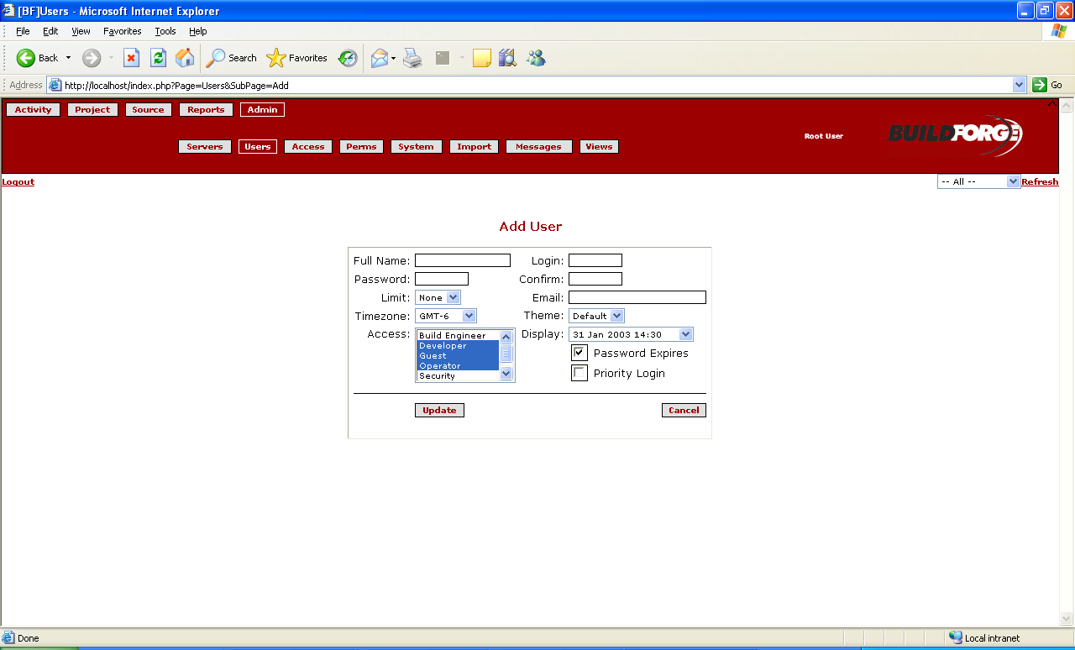
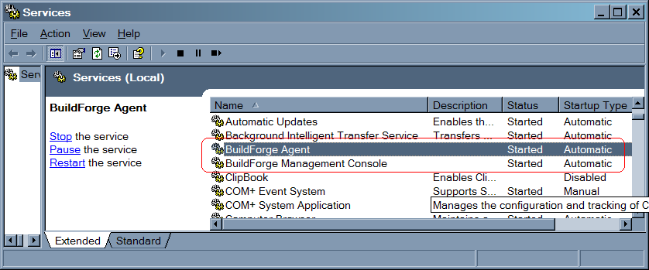
BuildForge & Terminology
Management Console
The component of the BuildForge system that is installed on a single machine to coordinate the system. You log in to the Management Console to start or schedule builds and to view results and reports.
The Management Console issues instructions to Agents.
Agent
The lightweight client component of the BuildForge system, which must be installed on any machine you want to use as a server in the system.
Each Agent communicates with the Management Console through the BuildForge Engine to get commands to execute on its server.
Management Console
The component of the BuildForge system that is installed on a single machine to coordinate the system. You log in to the Management Console to start or schedule builds and to view results and reports.
The Management Console issues instructions to Agents.

Slide 8
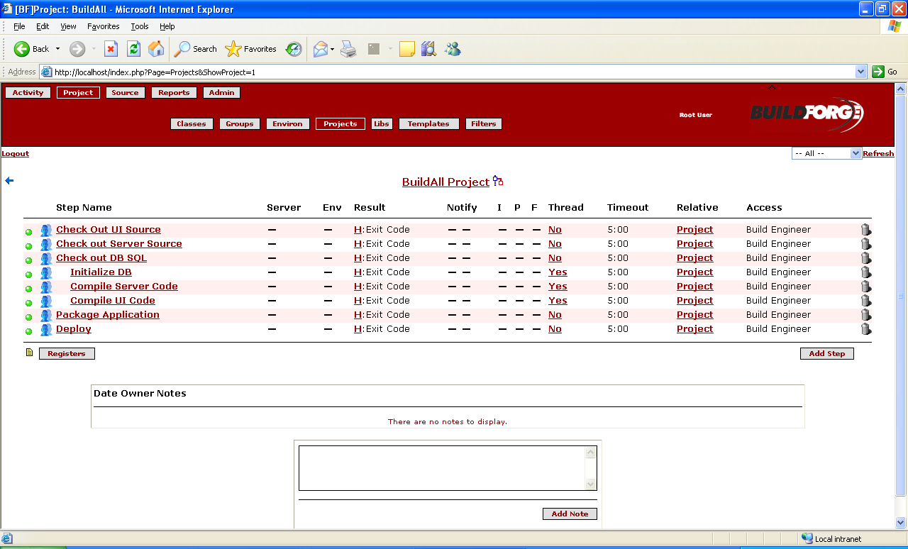
BuildForge & Terminology
Project:
A set of Steps which can be run in the BuildForge system. A project can be run repeatedly; each run generates a new Build.
Server: ( 60 k )
A Server is a logical resource in the BuildForge environment that represents any physical system running the BuildForge Agent.
A Server is defined within the BuildForge system with certain properties, such as a default path.
Adaptor: (ClearCase)
An adaptor is an add-on to BuildForge that allows the system to monitor and track changes in source code control systems and perform actions based on those changes.
When an adaptor is being used, the Bill of Materials (BOM) can report on changes to files that are under source code control.

Slide 9
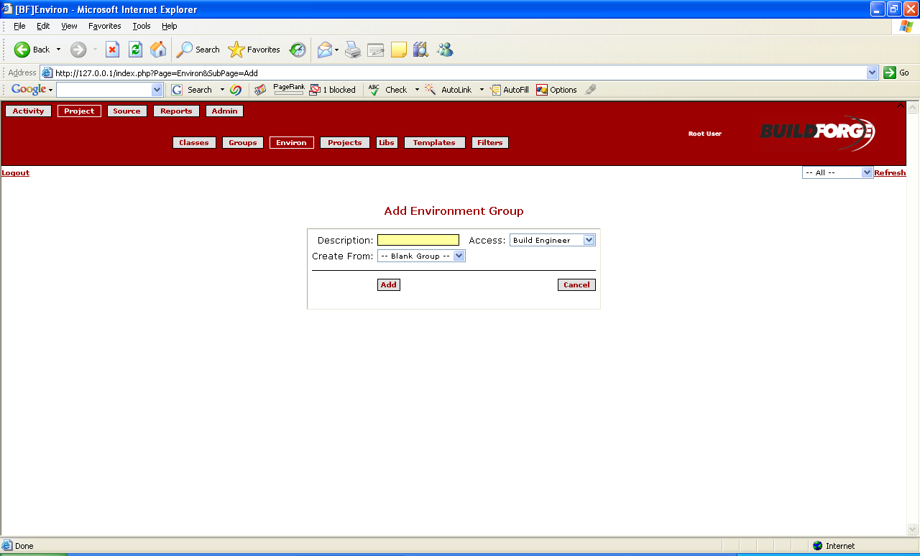
Environments
The BuildForge system allows you to manage environment variables separate from your Projects, Servers, and Steps
Define Environment Groups
  Containing one or more Environment Variables
You can assign Environment Groups to Servers, Projects, and Steps
  At runtime, the system assembles the final working environment for a Step from all of the relevant Groups assigned to the Server, Project, and Step

Slide 10
BuildForge - Financial Impact
Projected annual savings ranging from $250,000-$25M
Customer | CM Efficiency | Developer Efficiency | Quality / Error Reduction | Return on Investment
Electronic Gaming Company | Over 90% | 10-15% | 51-70% | < 3 months
Leading ISV | Over 90% | 10-15% | 51-70% | < 3 months
Top Hardware Provider | 80-90% | 20-25% | 80-90% | < 6 months
Major Financial Services Provider | 21-25% | 5-10% | 26-50% | < 6 months
Global Telecommunications Company | 51-70% | 26-50% | 51-70% | < 3 months
Source: Hurwitz Customer Benefit Study
November, 2005
Notes:
“Customers have received a significant return on investment from using BuildForge. ROI was typically obtained in the first three to six months of use.”
- Hurwitz
Electronic Arts: 4-month ROI; Reduced build times by 20x (60 to 3 hours).
Siemens: Build cycles increased 3X; Build times reduced by 65%; Secure developer self-service established; $6M savings over 3 years
Adobe: 4-month ROI; 20X Build Improvement - Removed need for additional CM’s; Initial deployment in 2 months – 50 products
Avaya: 3-month ROI; Build times reduced by 12x (12 hours to 1 hour); 30-120 minutes developer time saved per day; $3+ million savings over 3 years

Slide 11
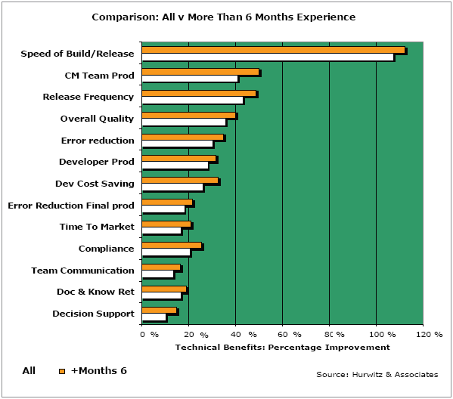
BuildForge - Technical Benefits
“We discovered that
new customers were
able to achieve results
similar to long-time
customers. This
validates BuildForge’s
claims that the product
can be implemented and
deployed in a relatively
short period of time.”
-- Hurwitz & Associates
Notes:
BuildForge Customers are realizing actual business benefit in terms of:
Reduced development cost – through standardized processes, team efficiency, and effective asset leverage, and hardware usage
Improved product quality – through reliable, repeatable processes and rapid error detection.
Better distributed and offshore team collaboration – through role-based access to shared processes and better handoffs
Faster time to market – through more frequent, iterative development cycles
Sustainable development compliance & governance – through self-documenting audit trails and deep process controls.

Slide 12
BuildForge Product Overview

Slide 13
System Overview
BUILD/RELEASE FRAMEWORK
Management Console
Centralized Web-based, Collaborative Distributed Access, Role-Based Security
IDE Plug-Ins
Developer Self-Service, Role-Based Security
Workflow
Control
Acceleration
Notification
Scheduling
Log Analysis
Tracking
Reporting
Process Automation
Automated, Repeatable Application Development Lifecycle
Development
Source
Control
Product
Build
Quality
Assurance
Package
Release
Scripting
Python, VBscript, Batch, Perl, KSH
IDEs
Languages
Source Control
Change Mgmt
Build Tools
Test Tools
Release Tools
ClearMake
Ant
NAnt
Make
GNUMake
NMake
Open Source
etc.
TestManager
Performance
Functional
Robot
LoadRunner
TestDirector
WinRunner
Junit
etc.
Tivoli
WebSphere
WebLogic
WIS
etc.
RAD
Eclipse
Visual .NET
Java
C
C++
C#
etc.
ClearCase
StarTeam
Perforce
CVS
PVCS
VSS
Synergy
Subversion
etc.
ClearQuest
Remedy
ChangeMan
Devtrack
Bugzilla
etc.
Platforms
UNIX, Windows Mac, Linux, Proprietary
Notes:
(Click One) Getting a product from initial coding all the way into production involves a complex task involving a network of people, processes, and technologies that need to be integrated.
(Click Two) The groups involved in critical phases—development, configuration management, QA, release, and customer support—are separated by organizational boundaries, disconnected toolsets, or vast geographies. Each team has its own processes, which are often manual and rarely documented. Essential tools such as bug-tracking databases and source code control systems are often disconnected and contain silos of critical information, but making them work with each other is difficult and time-consuming.
However, the ever-increasing demands for high-quality products at more frequent intervals, creates a need for a solid foundation of repeatability, reliability, and tracking.
(Click Three) Many teams have put together scripts to remedy these issues, however these scripts typically do not provide the ability to view and control builds and generally there are multiple versions to support multiple platform product lines. Plus you create a non-core product that requires time and key resources to maintain and enhance.
(Click Four) BF provides a framework to automate the *entire* process end-to-end. Not just automating individual tasks, but also the hand-offs among the various steps in the process. And BF was designed to integrate existing scripts and tools, so there is no need to replace those pre-existing assets. BuildForge offers a comprehensive Application Development Process Management solution that provides complete management & control of application development lifecycle. BuildForge automates, standardizes & optimizes complex processes, integrating diverse toolsets to deliver a repeatable and reliable application development lifecycle process.
(Click Five) Automation is really just the first piece of what BF does; we also provide value-added capabilities such as build acceleration, automatic notifications, etc. that are accessed through a secure, web-based interface that allows managed delegation of tasks to other groups - even offshore teams.
(Click Six) The result – faster development cycles, higher product quality, increased staff productivity, and a shorter time-to-market.

Slide 14
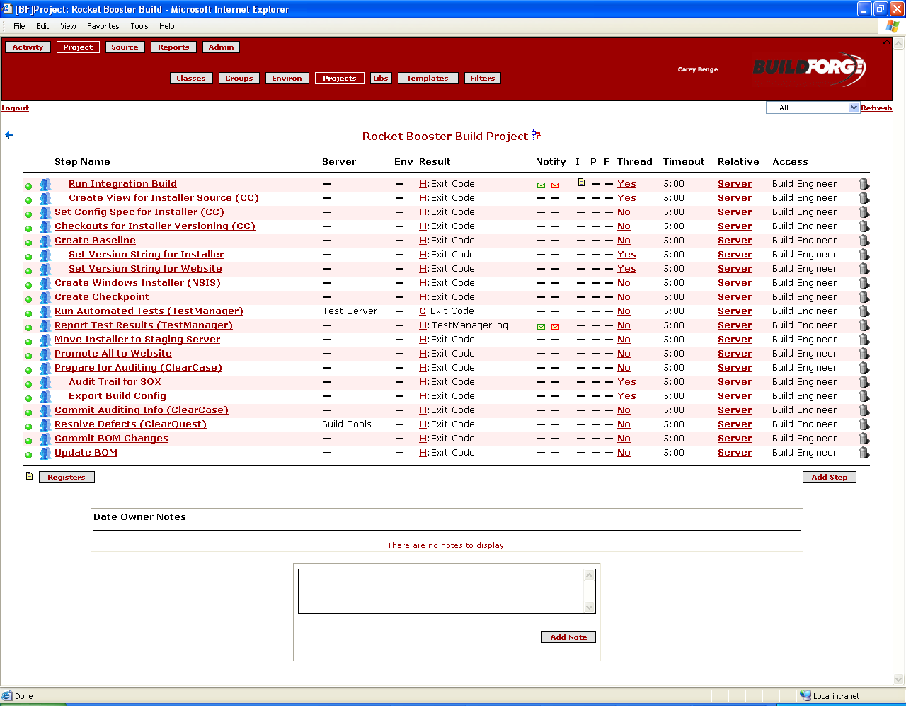




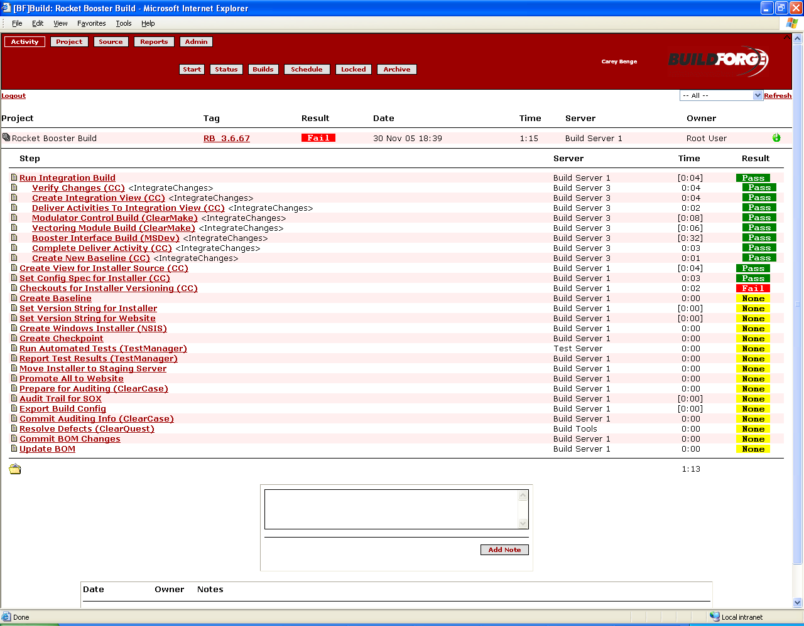

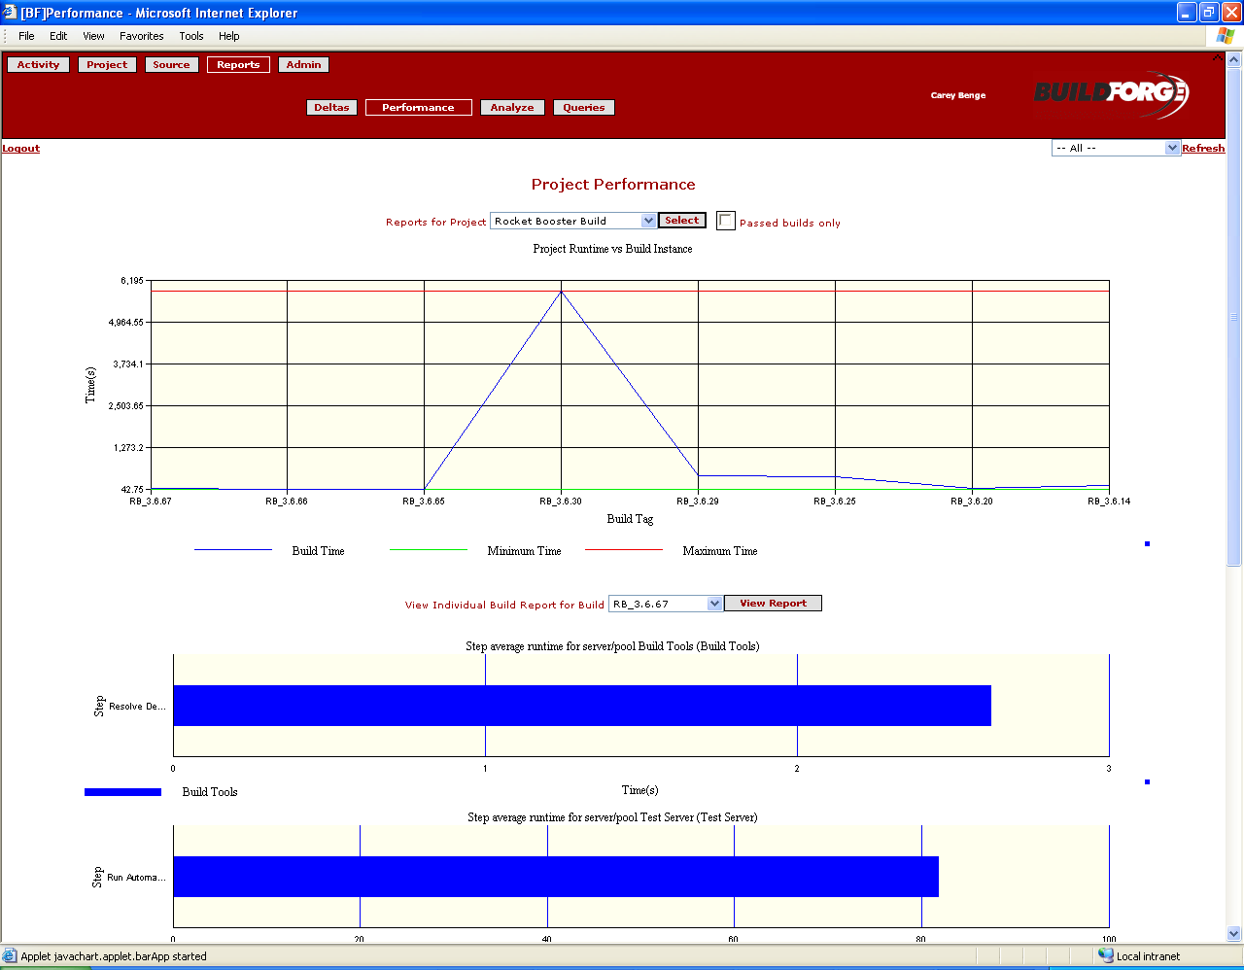
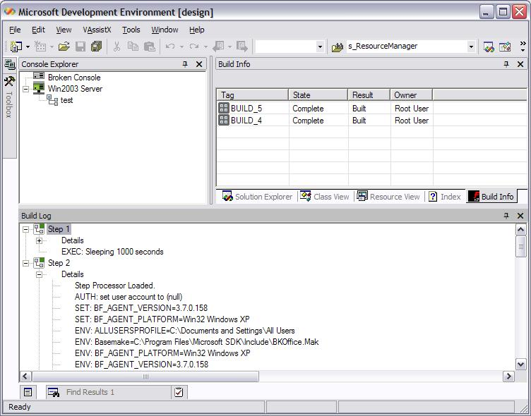

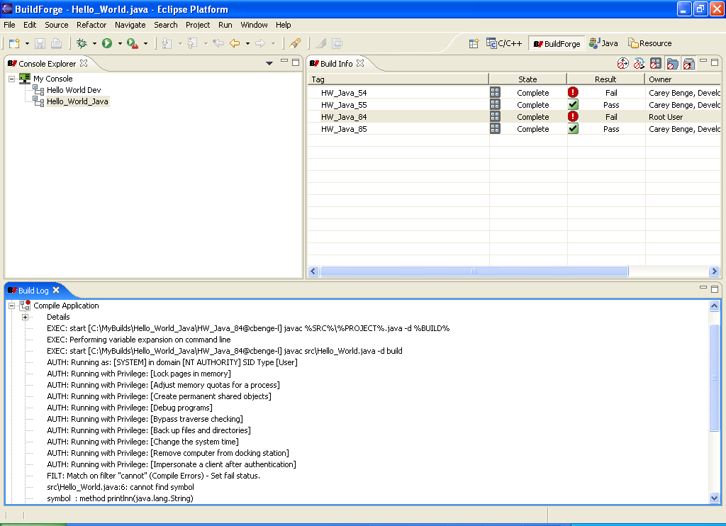


Functional Architecture
Manage
Implement
Execute
BuildForge Management Console
BuildForge Management Console
BuildForge
Agents
BuildForge Engine
Assign Project Steps
Send Notifications
Initiate Resource Cleanup
Server Pool
AIX
Linux
Windows
Windows
Windows
Austin
BuildForge Database
Projects and Steps
Server Configurations
Environment Configurations
User/Permission Information
Build Statistics
System Master Log
Windows
Mac
Windows
Solaris
AIX
Linux
Agents
Real Time Environment Configuration
Execute Project Steps
Report Statistics to Server
San Jose
BuildForge User Access
Bangalore
Integration
Management Console
Manage Users
Configure Resources
Set up Build Projects and Steps
Schedule Builds and View Status
Troubleshoot Build Issues
Reporting & Analysis
Integration
SCM, build, test, package, deployment systems
Source Code
Repositories
Test Suites
Deployment
Tools
SCM
Applications
Web Access
IDE Plugins
Notes:
BF is a typical tiered application.
In the middle is the BF Mgmt server which is the heart of the system. It’s responsible for managing logical servers, user access and security and automated processes
This BuildForge Systems in an enterprise-class 3-tiered standard web-based application. The system contains the following components:
BuildForge Management Server - the heart of the Buildforge System. It manages comprehensive project information and tracks each run of a project. It uses information entered to communicate with BuildForge Agents, execute project tasks, and perform notifications; it acts on instructions from the Management Console.
Management Console - provides a user interface to the system; it is a web-based PHP application that runs on an Apache HTTP server. Through it, you can organize commands into projects, and manage the server resources and environment variables those commands need.
BuildForge Agents are thin agents that run on worker machines that (1) Listen for instructions from the Management Server; (2) Execute given instructions; (3) Send results to the Management Server
Integration is accomplished using adapters that seamlessly integrate your existing IDE, SCM, build, test and deployment systems
cmd line integration
API level integration
Continuous integration / agile dev - adapters

Slide 15
Functional Architecture
ACCESS
IMPLEMENT
EXECUTE
BuildForge
Management Console
BuildForge
Server
BuildForge
Agents
Source Control
BuildForge Engine
3 Tier Architecture
Centrally Managed
Orchestrates BuildForge Tasks
Windows
Solaris
Linux
HP-UX
AIX
Build Systems
Manage Users
Configure Resources
Set up Build Projects and Steps
Schedule Builds and View Status
Troubleshoot Build Issues
Reporting & Analysis
Server Pool
BuildForge Database
Projects and Steps
Server Configurations
Environment Configurations
User/Permission Information
Build Statistics
System Master Log
AIX
Linux
Windows
Windows
Windows
Oracle
MySQL
SQL Server
Sybase
BuildForge
Prism
Windows
Solaris
Linux
HP-UX
AIX
Mac
Quality Assurance
Integration
Command Line
Adaptors
API
Windows
Solaris
Linux
HP-UX
AIX
Mac
Source Code
Repositories
Test Suites
Agents
Real Time Environment Configuration
Execute Project Steps
Return Output / Logs to Mgmt Server
Developer Self Service
Deployment
Tools
SCM
Applications
Notes:
Technologically, BuildForge is a typical 3-tiered system.
In the middle is the BuildForge Server. It is the heart of the system. It oversees all of the activities on the managed worker systems, organizes the projects, manages user access and permissions, logging, audit trails, etc.
The system runs on various databases. It comes with MySQL out of the box, but runs fine on Sybase, MS SQL, Oracle.
(Click One) The Management console is the main control UI for the system. It is a PHP-based web app running on an Apache HTTP server. Through it, you can organized commands into projects and manage the server resources and environments that those commands need.
BuildForge Prism provides the only solution on the market to provide developers seamless integration with IDE’s providing centralized access to build projects, status, and log file results directly within the IDE. Prism also provides the ability to selectively choose local file changes from within the IDE and preview the build results in a remotely staged, pre-configured environment, before committing the file changes to source code control.
(Click Two) BuildForge agents are deployed across worker machines. The agent is a very small process that does 3 basic things:
1 - Listens for instructions from the Mgmt. Server.
2 - Executes those instructions
3 - Sends results from the instructions back tothe Mgmt. Server.
LASTLY
Integration in the system from both the user and server side provides integration capabilities to seamlessly integrate your existing IDE, SCM, build, test, and deployment systems through:
*Command-line integrations
*API-level integrations
*Continuous / agile development adapters

Slide 16



Data Elements…Building Blocks…
Individual tasks performed as part of a project. Each contains one or more command line statements to be executed on a server machine. A step can run a script, invoke another application, move or copy files, export a project for backup, and more.
1a. cleartool mkview -tag $BF_TAG \\views\$BF_TAG
1b. cleartool setcs -tag $BF_TAG config.spec
Steps
2a. gcc main.c -o main.o
2b. gcc main.c -o ui.o
2c. gcc main.o ui.o –o HelloWorld.exe
3a. testscript.sh –run –r $RELEASE –module HelloWorld.exe
Containers that hold a series of steps necessary to execute a process.
A project can contain a series of diverse tasks beyond the compile, including automated tests, running installers, updating databases, or a website update.
…
Project
Source
Build
Test
Package
Deploy
1. RELEASE=Release_1.1
2. JAVA_HOME=C:\Program Files\Java\jdk1.5.0_06
3. PATH=C:\:\Program Files\Java\jdk1.5.0_06\bin
4. …
Collections of environment variables which can be maintained separate from projects and steps, then assigned to projects and steps as needed.
Environment
Notes:
ARRIVAL
There are 3 primary components that exist in the system to automate Application Dev. Lifecycle. The top-level component is a project.
(Click One) [Paraphrase what is on the screen]
(Click Two) Just do the click to emphasize what it says in CLICK 1
(Click Three) Steps are the next level down in granularity - these are the various tasks performed in the project. Each step is one or more command line statement to be executed on a worker machine or machines. [Paraphrase examples from slide]
(Click Four) So for example...
(Click Five) An Environment is a collection of environment variables. These are maintained separately from both projects and steps and can be assigned to projects and steps as needed. Leads to a high level of configurability and enables reuse.

Slide 17
Data Elements
Containers that hold a series of steps necessary to execute a process.
A project can contain a series of diverse tasks beyond the compile, including automated tests, running installers, updating databases, or a website update.
…
Project
Source
Build
Test
Package
Deploy
Individual tasks performed as part of a project. Each contains one or more command line statements to be executed on a server machine. A step can run a script, invoke another application, move or copy files, export a project for backup, and more.
1. cleartool startview $VIEW
2. cleartool mkbl -c "Build $BF_TAG" -full -view $VIEW $BF_TAG
3. cleartool diffbl -act $BASELINE@$VOB $BF_TAG@$VOB
4. …
Steps
1. VOB=
2. VIEW=HelloWorldJava
3. JAVA_HOME=C:\Program Files\Java\jdk1.5.0_06
4. PATH=C:\:\Program Files\Java\jdk1.5.0_06\bin
Collections of environment variables which can be maintained separate from projects and steps, then assigned to projects and steps as needed.
Environment
Notes:
ARRIVAL
There are 3 primary components that exist in the system to automate Application Dev. Lifecycle. The top-level component is a project.
(Click One) [Paraphrase what is on the screen]
(Click Two) Just do the click to emphasize what it says in CLICK 1
(Click Three) Steps are the next level down in granularity - these are the various tasks performed in the project. Each step is one or more command line statement to be executed on a worker machine or machines. [Paraphrase examples from slide]
(Click Four) So for example...
(Click Five) An Environment is a collection of environment variables. These are maintained separately from both projects and steps and can be assigned to projects and steps as needed. Leads to a high level of configurability and enables reuse.

Slide 18

Operational Architecture…Putting it all together…
Notification
Scheduling
Log Analysis
Tracking
Project/Process
Workflow
Compile Linux
Analysis
Control
Compile Solaris
Reporting
Init
Get Src
Test
Package
Deploy
Compile Windows
(main)
Environment
Link Windows
(main, ui)
Compile Windows
(ui)
Reusable Steps
Threading
Pooling
Notes:
First Click: Begin by defining your process. Create step for each phase in your development lifecycle from build to deploy This is often a sequence of application executions that produce a tangible output. Place that process within a BuildForge project.
Second Click: Configure more advanced capabilities.
(Click One) This slide sums up the organization of an example process. By chaining projects and steps together, you can create an automated, managed lifecycle from build to deployment.
[speak briefly to the pattern on the slide]
[Highlight ability to reuse]
(Click Two) Execution of all of these projects/steps is wrappered by the capabilities of the BuildForge platform.
[just use a few examples]
Notifications – more than just “build’s done” notifications – more granular. And the build engineers didn’t have to skip their day jobs to write a bunch of Perl notification scripts.
Scheduling – across all platforms
Threading – ability to parallelize tasks
Pooling – part of threading capability that adds load balancing & fail-over to the process
Built in cleanup of old builds / archiving
Reports more than just auditing – include info on iteration speed, performance, optimization, QA, etc.

Slide 19
IBM Rational Software Development Platform
GOVERNANCE DASHBOARD
Solutions for geographically distributed development, compliance, SOA
Process & portfolio management
IBM Rational® Portfolio Manager
IBM Rational Method Composer
Best practices content (IBM Rational Unified Process® IBM Tivoli Unified Process®, Portfolio Management)
Requirements & analysis
Design & construction
Software quality
IBM WebSphere®
Business Integration Modeler
IBM Rational RequisitePro®
IBM Rational Software Architect
IBM Rational Software Modeler
IBM Rational Rose®
Data Modeler
IBM Rational Software Architect
IBM Rational Software Modeler
IBM Rational
Application Developer
IBM Rational Systems Developer
IBM WebSphere
Integration Developer
IBM Rational
Performance Tester
IBM Rational Functional Tester
IBM Rational Manual Tester
IBM Rational PurifyPlus
Change & configuration management
IBM Rational ClearCase®
IBM Rational ClearQuest®
IBM Rational Team Unifying Platform™
IBM Tivoli Provisioning Manager
IBM Tivoli Configuration Manager
IBM Rational BuildForge
Partner ecosystem & open computing
EclipseTM, Linux®, Microsoft® Windows®, UNIX®, IBM z/OS®
Notes:
IBM Rational Platform for Business Driven Development
Main point:
We’re able to deliver this capabilities with a full portfolio of modular, open-standards-based products and services. Based on your existing development technologies and where you are in the process of evolving to Business Driven Development, we’re can work with you to design a solution specific to your governance needs.
Segue: To best illustrate the scope and benefits of the Rational solution, let’s take a look at some common initiatives in this new world of business to see how it can help you to govern software development and delivery effectively.
IBM Rational Software Development Platform
Main point:
We’re able to deliver this capabilities with a full portfolio of modular, open-standards-based products and services. Based on your existing development technologies and where you are in the process of evolving to Business Driven Development, we’re can work with you to design a solution specific to your governance needs.
Segue: To best illustrate the scope and benefits of the Rational solution, let’s take a look at some common initiatives in this new world of business to see how it can help you to govern software development and delivery effectively.

Slide 20
Business Driven Development offerings
Change and configuration management
GOVERNANCE DASHBOARD
Process & portfolio management
Requirements & analysis
Design & construction
Business driven process
Change & configuration management
Software quality
Benefits
Capabilities
Key Products
Quickly respond
to change
Develop
anytime, anywhere
Ensure
predictable results
Promote and
support reuse
Change and
asset management
Build and
release management
Flexible workflow support
Traceability across
the lifecycle
IBM Rational ClearCase
IBM Rational ClearQuest
IBM Rational Team
Unifying Platform
IBM z/OS SCLM Suite
IBM Rational BuildForge
Notes:
How does Rational make this possible?
The IBM Rational solution enable you to manage value with:
Real-time analytics linking financial and software information
Real-time resource management
Comprehensive dashboard reporting and drilldown
You can make the most flexible use of your development assets and resources with:
Proven best practices
Integrated requirements management
SOA design and construction capabilities
Open, role-based team environment
And, you’re better able to control risk and change with:
Lifecycle change and asset management
Built-in audit and status information on projects and assets
Performance testing
Service-level monitoring
Segue: To best illustrate these benefits, let’s take a look at some common initiatives in this new world of business to see how IBM Rational can help you govern software development and delivery effectively.

Slide 21
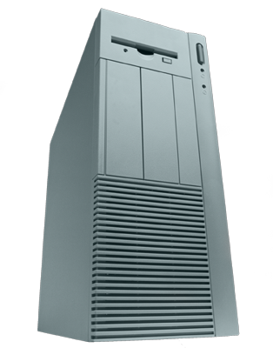
From Workgroup to Enterprise
IBM Rational ClearCase MultiSite
IBM Rational ClearQuest MultiSite
Add-on
IBM Rational ClearCase
IBM Rational ClearQuest
IBM Rational BuildForge
Enterprise Edition
Distributed Team
Development
Upgrade
Dynamic Views
IBM Rational ClearCase LT
IBM Rational ClearQuest
IBM Rational BuildForge
Standard Edition
Advanced Build Management
Snapshot Views
UCM Process
Activity-Based Change Management
Single
Server
Distributed
Servers
Replicated
Servers
Individual Workgroups Medium-Large Teams Remote Teams
Notes:
One Main Point: Rational’s SCM solution is good for small teams and large, and scales gracefully as teams grow..
“…Rational ClearCase provides this scalability by providing a family of solutions depending on your needs. Rational ClearCase LT is especially suited to workgroups – those relatively small project teams that are all located together.
“When the team grows you can step up to ClearCase – the full featured product that supports your needs as your teams expands with features like support for distributed servers and advanced build management. Rational ClearCase LT as well as Rational ClearCase integrate with Rational ClearQuest, so ClearQuest provides defect and change tracking facilities in these scenarios.
“And when you get so big that your team is no longer centrally located, you just expand your installation to include Rational ClearCase MultiSite and ClearQuest MultiSite.
The important thing to note is that you can do this without reformatting your databases, changing your workflows or your processes. Once you start with the Rational SCM family, you need never replace your configuration management system again!

Slide 22
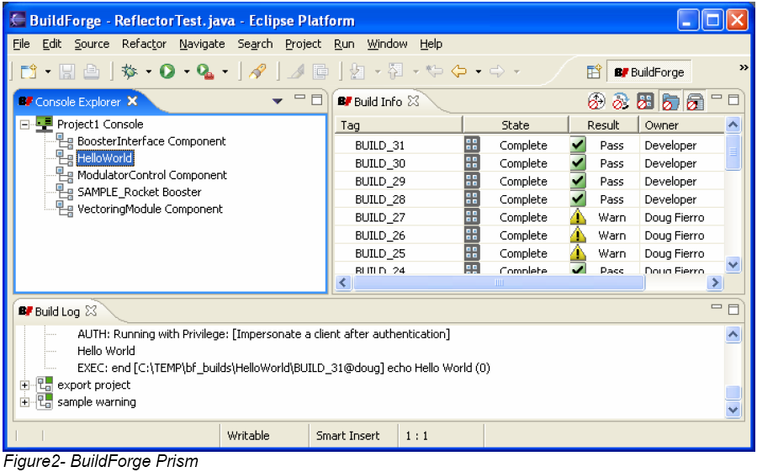
BuildForge RAD/Eclipse Plug-in
Developer self service
  Controlled access to established build processes helps break down the wall between development and CM/build activities and eliminates manual bottlenecks.
  Developers can build their projects on demand and view results leveraging pre-configured environments and resources, all without having to leave their IDE.
Pre-flight build support
  Improve quality and reduce build errors with the ability to take local file changes within RAD on the developer’s desktop and run them through established build processes before committing source changes to check-in.
Build acceleration
  Help speed up builds by breaking up a build into smaller, self contained components and executing them in parallel across one or more machines.

Slide 23
BuildForge Source Code Adaptor for Rational ClearCase
BuildForge provides continuous monitoring of the ClearCase source repository, and executes builds automatically either when a change occurs or on a scheduled basis.
The adaptor gathers and reports source metrics for each software build.
For each of the views defined, BuildForge scans the specified list of VOBs at scheduled intervals for changed files since the last successful build for a project, and collects the file differences and check-in comments.
A document view of each build session is captured and recorded in BuildForge, called a bill of materials, which includes the associated ClearCase information.

Slide 24
BuildForge Defect Tracking Adaptor for Rational ClearQuest
BuildForge can automatically detect ClearQuest activities that are part of a current build session
These activities are recorded during the build process and are part of the build record stored in BuildForge.
Upon successful build exit status, BuildForge can automatically advance the state of the associated ClearQuest activities to a resolved status, and include a note from the build session.
BuildForge can leverage Rational ClearQuest Test Management to automate the execution of tests for successful builds and record the test results for viewing or printing.

Slide 25



































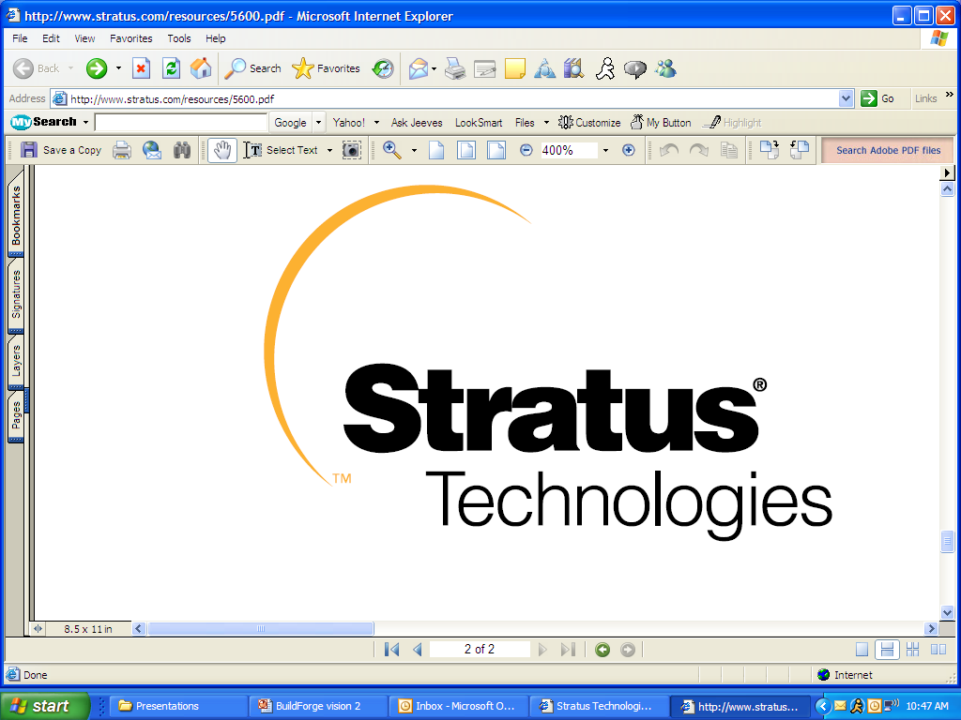





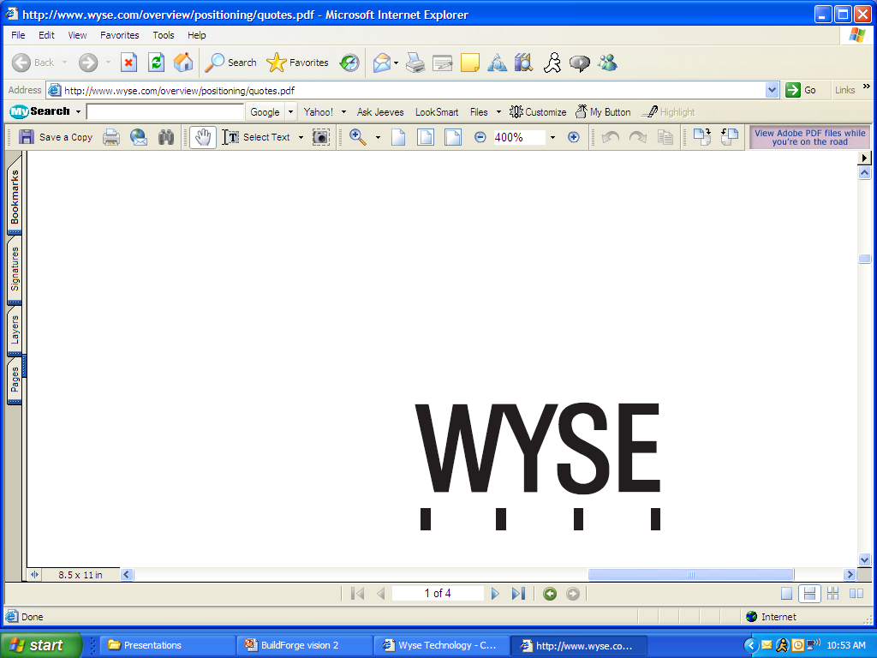

Customers
OpenView
LaserJet

Slide 26
Identifying a BuildForge Opportunity
Emeka Obianwu (eobianwu@us.ibm.com)
November 7, 2026
IBM Internal Use Only

Slide 27
“Where There’s Smoke…”
Buyer: VP/Director of Software Development
  Manages developers, testers, and build engineers
  Buy signs
    Fairly large team (>100 developers)
    Complex build environment: application runs on multiple platforms, team is geographically distributed, large application with very long build times, mixed SCM environment
    Failed audit or concerned about compliancy around process standardization and repeatability
  Compelling events
    Audit or compliance pressure (SarBox, CMMI, etc.)
    Acquisition adds geographically distributed teams and new development tools (SCM, etc.)
Primary Influencer: Build & Release Engineer, Configuration Managers
  Concerns resolved: reuse existing tools and scripts, remove manual handoff bottlenecks, self-documenting process

Slide 28
Handling Objections
Status Quo
  Build Forge achieves very quick time-to-value through reuse of existing tools and scripts
  Build engineers and configuration managers to not have to rewrite proprietary scripting
Competitive – Cruise Control, Anthill, OpenMake, etc.
  Build Forge build automation does everything these products do PLUS
  Self-documenting bill of materials supports reproducibility and traceability
  Many clients actually use Build Forge with these products as superset or have replaced open source with Build Forge to support scalability and manageability
Non-IBM or mixed SCM environment
  Build Forge with the Adaptor Toolkit facilitates automation integration with virtually any ALM product
  Kit includes out-of-the-box adaptors for Borland StarTeam, Microsoft VSS, Serena Dimensions and PVCS, CA Harvest, CVS, Perforce, and Subversion
  Adaptors can be modified to integrate other SCM tools including home grown
  Custom adaptors can be built for defect tracking, testing tools, and packaging

Slide 29
Playbook
Big ClearCase/ClearQuest Add-on
  Build automation and acceleration improves build efficiency allowing more frequent build iterations, higher quality, and improved team efficiency and closes the gap between coding, testing, and deploying
Greenfield
  By combining Build Forge with the Rational Development Platform and Tivoli Provisioning Manager, IBM helps close the gap between writing code, building the executable artifacts, and deploying them to test and production environments
Competitive – Trojan Horse
  Customers that have competitive SCM products or mixed environments can value from Build Forge using adaptors for Serena PVCS and Dimensions, Borland StarTeam, Microsoft VSS, CA Harvest, Perforce, CVS, and Subversion. Once deployed you can sell the additional value of tighter integration with ClearCase and ClearQuest
Small ClearCase
  Build Forge achieves a very rapid time-to-value allowing customers to start realizing value and payback within weeks.

Slide 30
Engagement Model
Qualify Build Forge opportunities in any of the plays above
Contact Build Forge sales specialist for your territory
  Territory list is available at http://w3-103.ibm.com/software/xl/portal/resources/attachment/R9/K016611M22978W31/BuildForge Sales Territories.xls
Engage local technical sales representative for pre-sales and POC assistance
Team sell with Build Forge sales specialist
Incentive
  Qualifying new Build Forge deals that are $100K or larger and close in Q206 receive a 5% incentive for material contribution-Rational SSR and TSR only
  Qualifying Q206 cross-sells $100K or greater with a new Rational sale or a sale to existing customer receive a 5% incentive for material contribution-Rational SSR and TSR only
  Qualifying new sales or cross-sells by tele SSR on Q206 deals $50K or greater receive a 3% incentive for material contribution-Rational tele SSR only

Slide 31
Questions?
Follow-up questions, comments:
  Doug Fierro
  Product Manager for IBM Rational BuildForge
  dfierro@us.ibm.com
  512 225 0436
Thank You!

